Slide 1
Journalistic Data Mining
JOUR479V/779V – Computational Journalism
University of Maryland, College Park
Nick Diakopoulos, Ph.D.

Slide 2
Use Cases
Social Media
Social listening, verification
Investigative Journalism
Analyzing document dumps or scrapes
Content Optimization
Headline Testing
Business Operations
Subscriptions, churn
Notes:
Computing helps with scale of data in these various scenarios

Slide 3
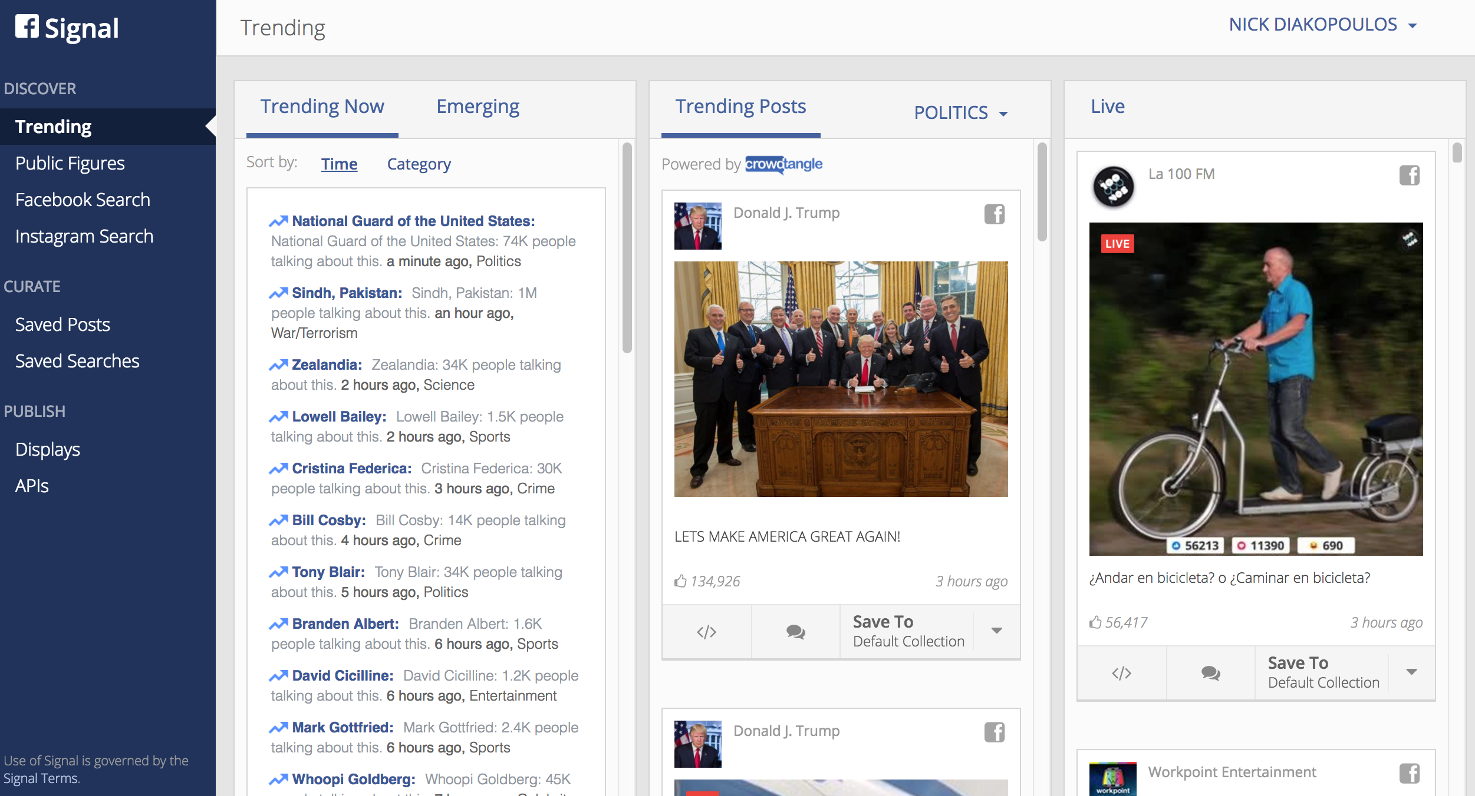
FB Signal
https://signal.fb.com/#/dashboard
Notes:
FB signal is another social listening tool that supports discovering trending topics, tracking names entities in terms of mentions, and searching FB or instagram. As has an ability to see “emerging” trends which have been picked up by algorithm but not yet curated / vetted.

Slide 4
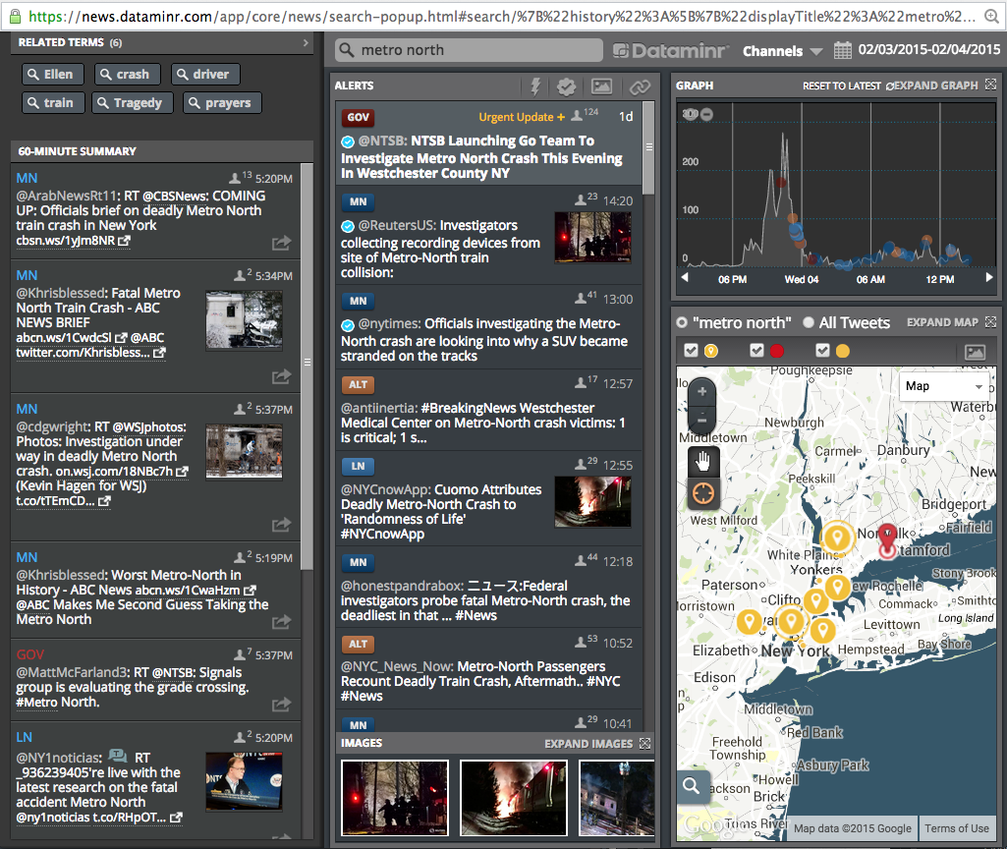
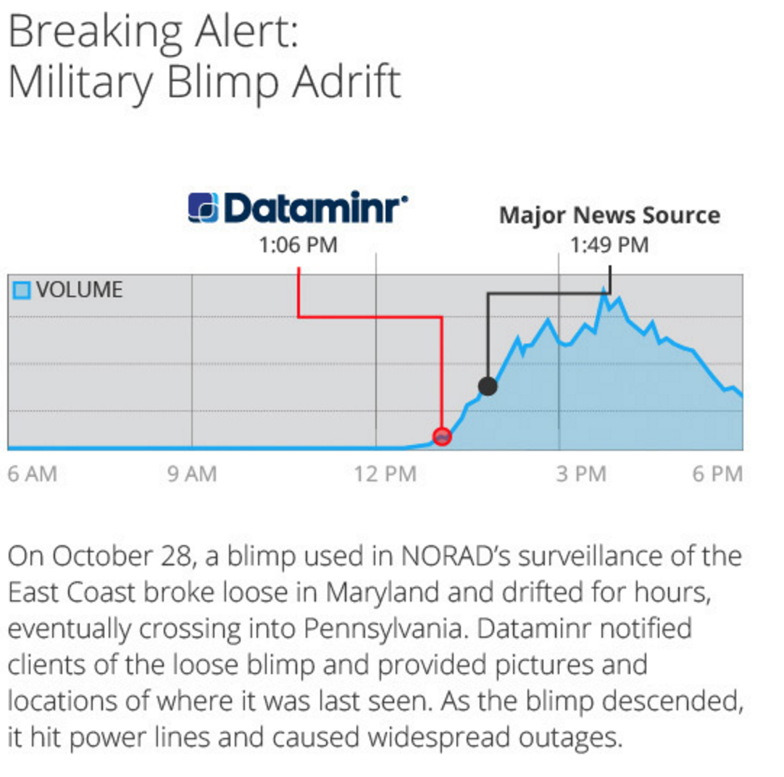
Dataminr
Notes:
As of April 2015 Dataminr was used by 200 news orgs

Slide 5
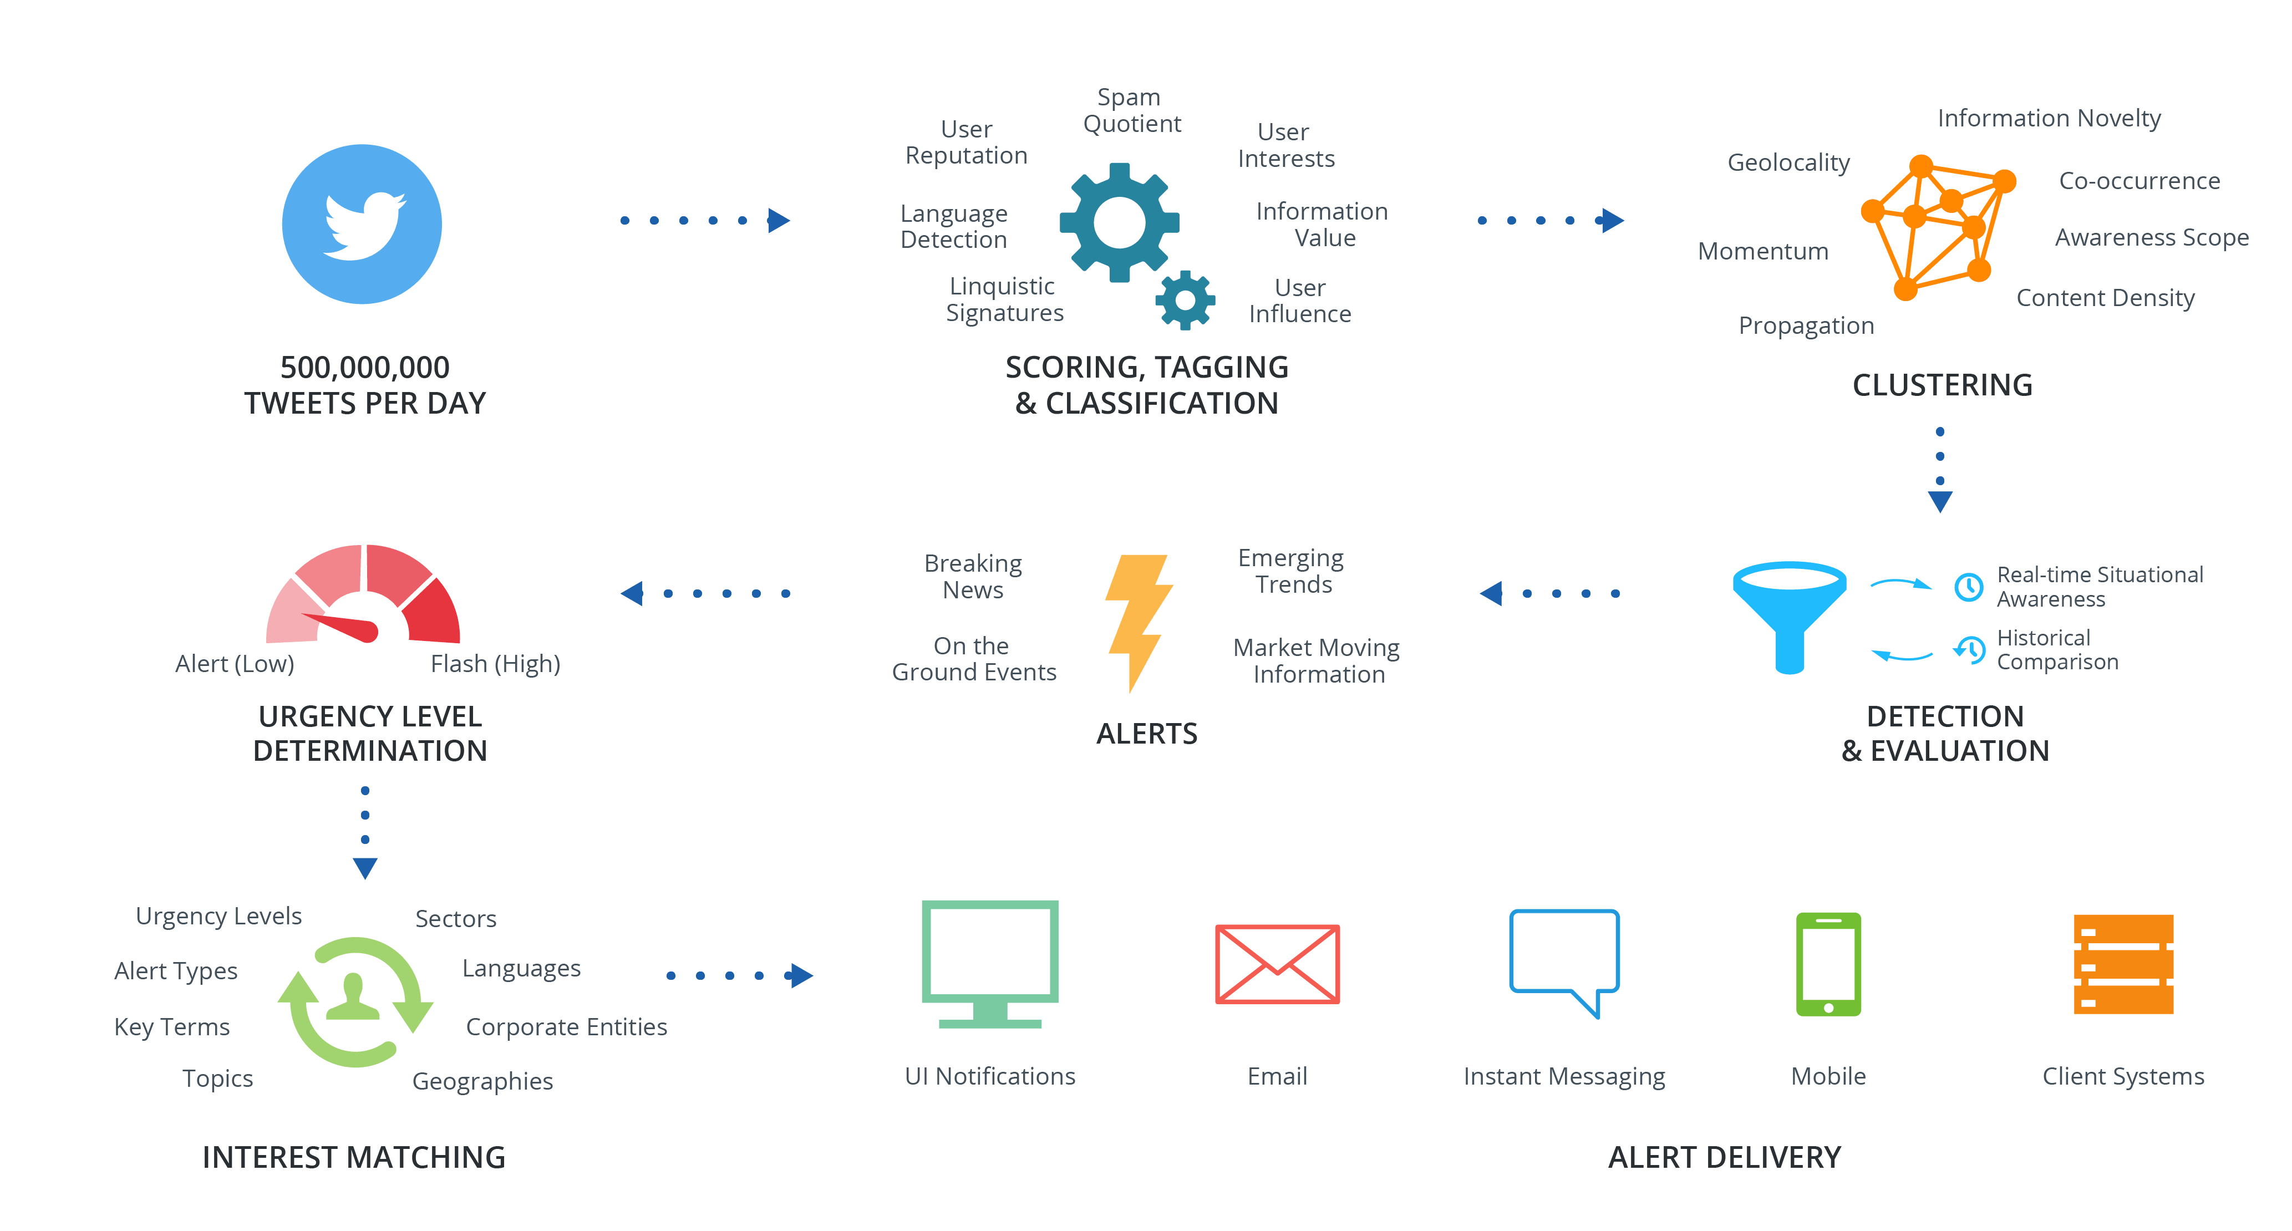
Dataminr Process
Notes:
Where are editorial decisions in this process?

Slide 6
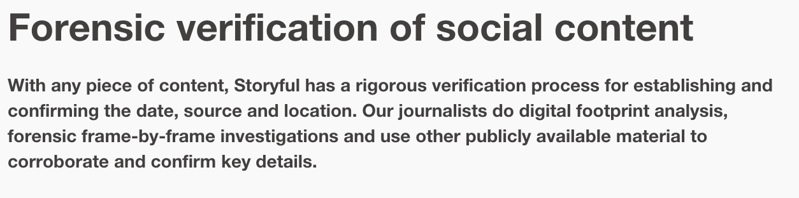
Content Verification
Social Media Forensics
Trust, expertise evaluation, eyewitnesses, debunking, independence, provenance
Storyful
https://storyful.com/case-study/forensic-verification-of-social-content/
https://storyful.com/blog/2016/11/22/introducing-verify-your-direct-line-from-the-social-web-to-storyful/#.WHbqmeErJR4
Notes:
Increasingly relevant to in today’s “fake news” world
Other techniques involve using reverse image search, looking at more social media context (e.g. age of account) and who they’re connected to.

Slide 7

Photo Tampering Detection
http://www.fourandsix.com/blog/2013/4/2/the-pixel-arms-race.html
Notes:
An image of an Iranian missile test appeared on the front page of many major newspapers. The image was from the web site of Sepah News, the media arm of Iran’s Revolutionary Guards. After the publication of this photo, it was revealed that the second missile from the right was digitally added to the image in order to conceal a missile on the ground that did not fire.
This type of manipulation can be found via software that can look at repeated pixels or statistical discontinuities in the pixels that suggest it is not “natural”.

Slide 8
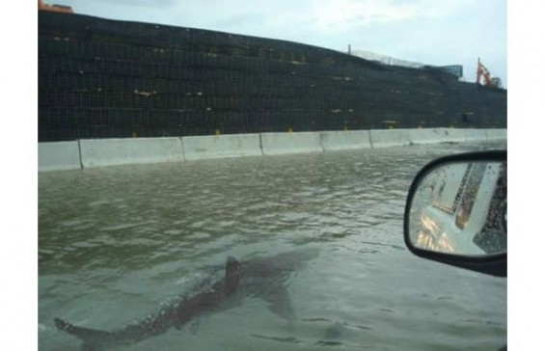
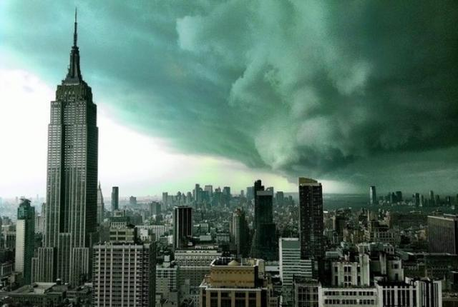
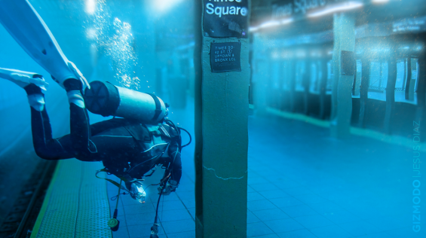
Which is real hurricane Sandy photo?
Notes:
Answer to the question: None of them are from Sandry. The last image is actually real but it is from a tornado brewing not from the hurricane.
Another issue that journalists have to deal with are rumours. Stuff goes viral all the time and journalists need to have their guard up to investigate the real from the fake.

Slide 9
Implications of Social Listening
Verification at scale is hard
Algorithmic biases in selection / filtering
Ethics / privacy of use of volunteered information in news reporting

Slide 10

Investigating with Machine Learning
http://doctors.ajc.com/about_this_investigation/
Notes:
Scrape documents online – had 100k and used ML to classify the most likely to be journalistically interesting to the investigation. Resulted in only 6k that needed to be read by investigators.

Slide 11

Conceptual Process
100 k documents
Train machine learning classifier to learn pattern of what’s interesting in those 500
Read through some subset sample and find say 500 that are “interesting”
Training
94 k
100 k documents
ML Classifier
Uninteresting
Usage
6k
Interesting
Notes:
Talk about errors here and the risk of a FP or FN

Slide 12
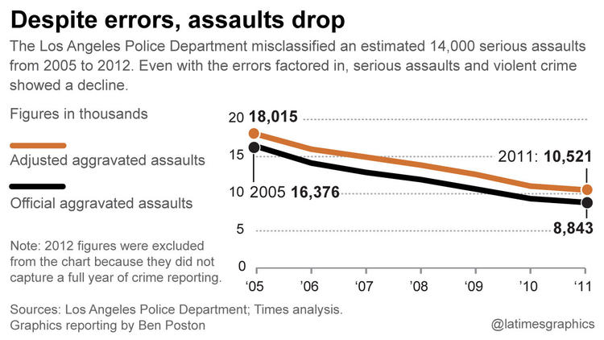
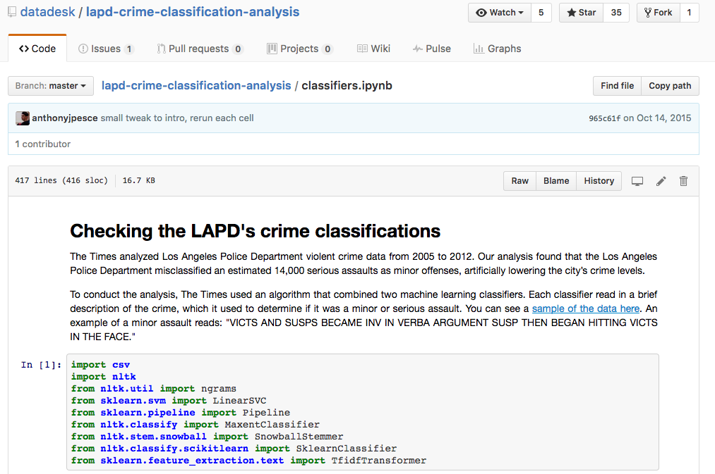
Notes:
Another example.
http://www.latimes.com/local/cityhall/la-me-crime-stats-20151015-story.html
https://github.com/datadesk/lapd-crime-classification-analysis

Slide 13
Implications
Can dramatically increase scale of investigations by focusing attention
What about errors? What happens if the machine learned classifier is wrong?

Slide 14
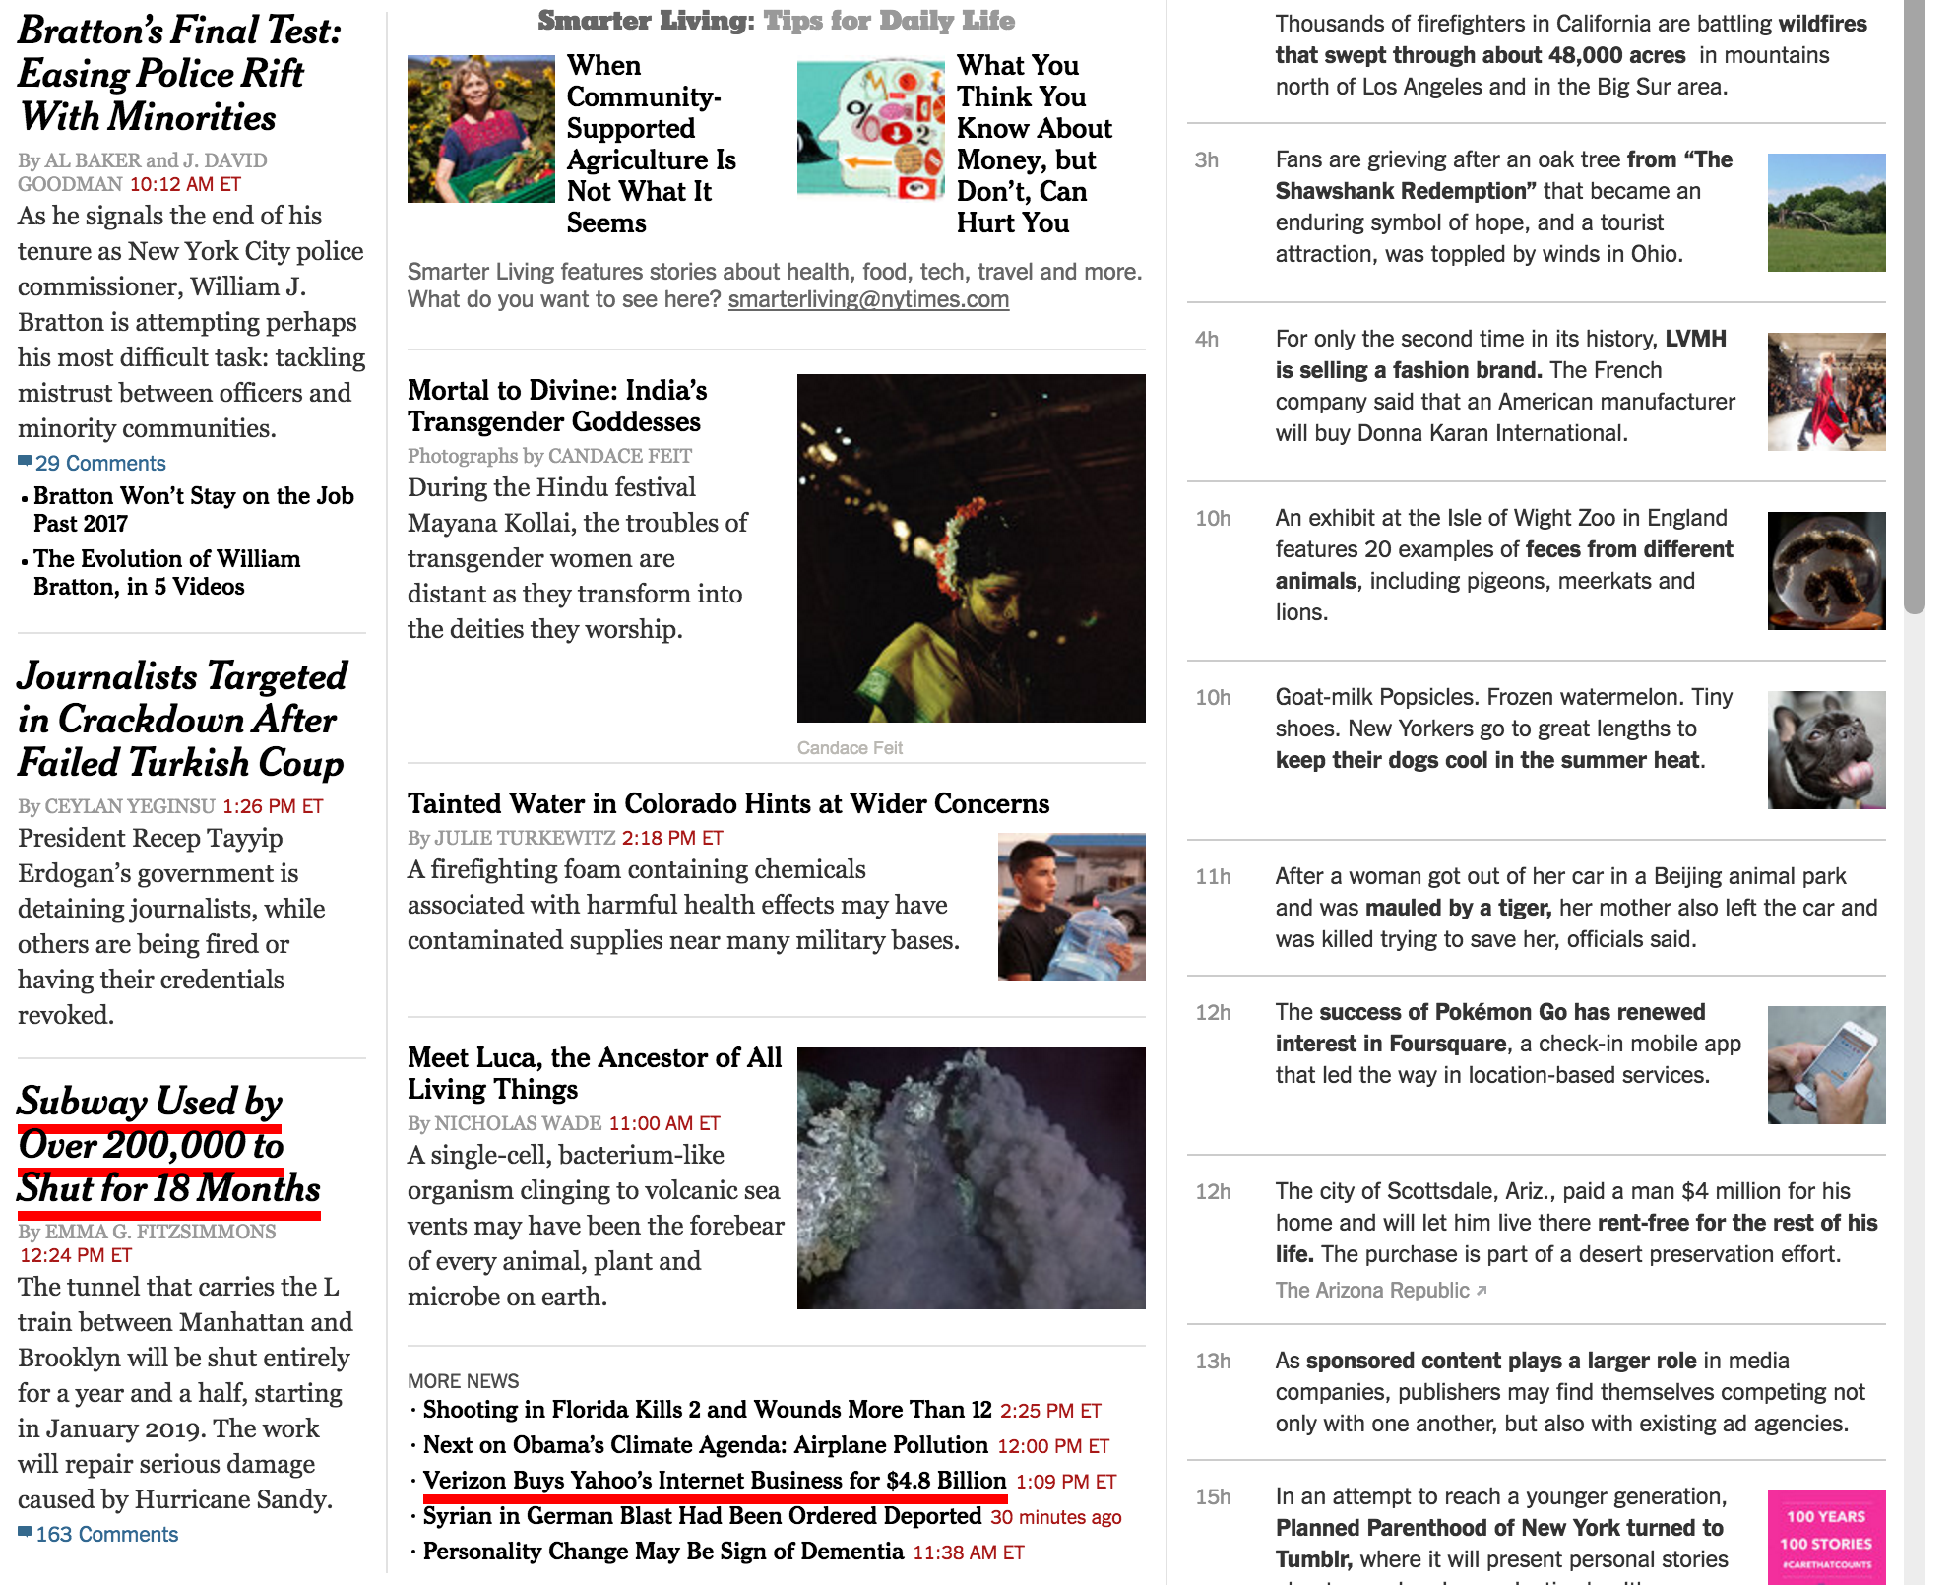
Headline A/B Testing
Notes:
Pessimizely is a chrome plugin that will highlight headlines being tested using a headline A/B tool called optimizly.
The way it’s used is that journalists write alternative headlines and then each time the page is served a different one is tried of the options until the math shows that one has better click-through.

Slide 15
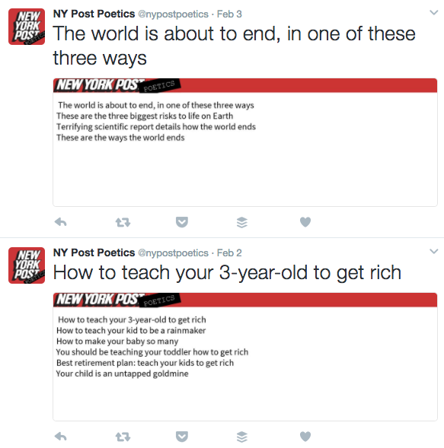
Headline A/B Testing
Notes:
ProPublica built a bot that exposes some of the headlines being tested by the NY Post.

Slide 16
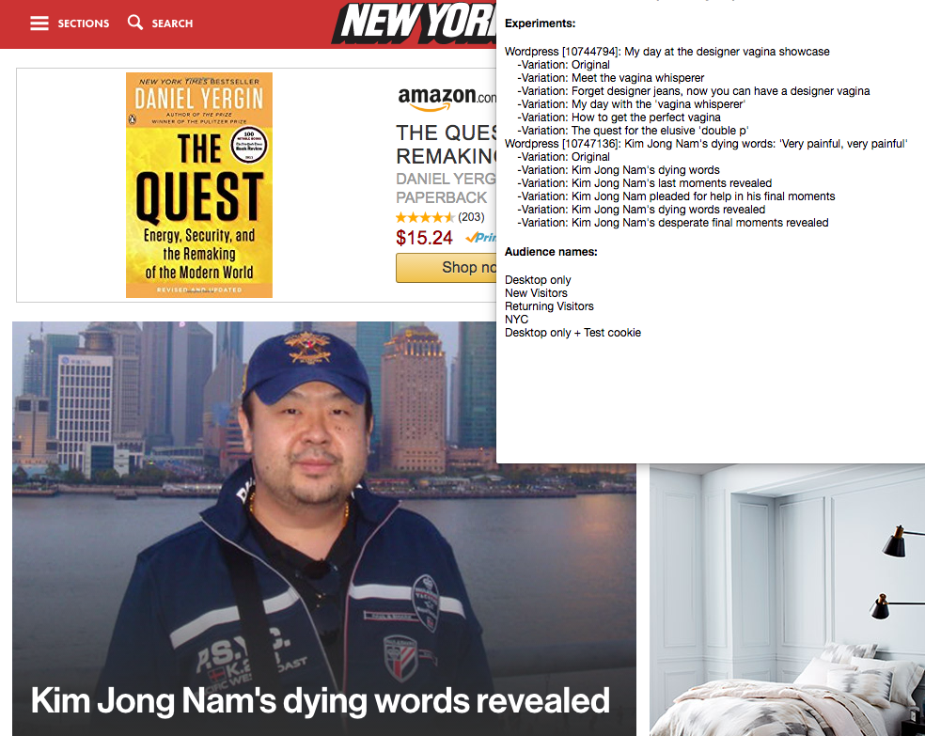
Optimizely Chrome Plugin
Notes:
What are some potential issues with optimizing for click through of headlines?

Slide 17
Readings
The Age of the Cyborg
What’s the significance of the two design dimensions (task clarity and information location) to cyborg journalism?
Does this article change your view of automated journalism that we talked about last week?
Notes:
Task clarity is about knowing exactly what the task is and having all of the information necessary to solve the problem at hand.
Information location refers to whether the computer even has access to the data / information it would need to get the story. Sometimes information needs to be extracted from new sources which are unknown.

Slide 18
Readings
Finding the news lead in the data haystack
The Marple system they built monitors counts of crime over time. In what other domains might a similar approach be useful / meaningful?
What might be the long term effects of false alarms?
Notes:
Other domains: unemployment, immigration, housing prices, public health.

Slide 19
Readings
The new importance of ‘social listening’ tools
What types of stories might these tools miss?
How is the use of these tools likely to bias news coverage?
How might tools like Dataminr be manipulated or misled by fake news, misinformation, or disinformation?
Notes:
Could miss foreign language media, or stories that build slowly and don’t have high “social velocity”, and it’s biased towards popularity.
Another interesting question: If you were a PR firm how might you try to game the system to get your content to show up as an alert on Dataminr or Newswhip?
Garbage in / garbage out. If people are untertaking coordinated campaigns to manipulate social media it’s not clear algorithms like dataminr’s will be resilient. Do we need to start thinking about security of manipulation of social media?

Slide 20
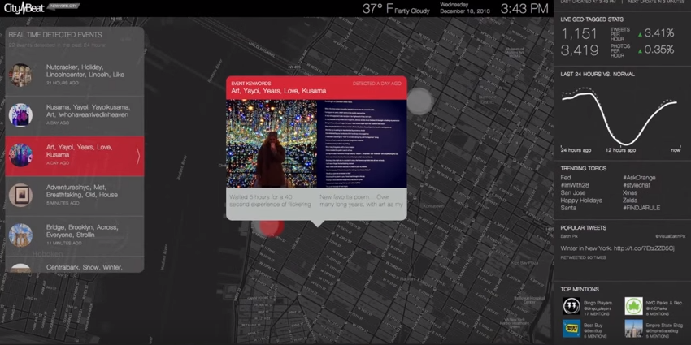
Readings
Editorial algorithms: using social media to discover and report local news
https://www.youtube.com/watch?v=ihMOIzeL9Mc
Notes:
https://www.youtube.com/watch?v=ihMOIzeL9Mc

Slide 21
Readings
Editorial algorithms: using social media to discover and report local news
What’s one possible definition of newsworthiness explored in the paper? What are challenges to getting algorithms to understand what is newsworthy?
What are implications of only using Instagram data in the tool to detect events?
Notes:
Newsworthy as “unusual”
Challenges: different outlets have different definitions and audiences, different sets of SM inputs, geographic context / proximity may affect what’s newsworthy, ability to detect PR events.

Slide 22


Slide 23
Questions?
Don’t forget Code Circle
Tuesday, 2/20, 4:30-7pm in Knight 3207

